Slide 1
Management
Eleventh Edition
Chapter 3
Managing in a Global Environment
Copyright © 2018, 2016, 2014 Pearson Education, Inc. All Rights Reserved

Slide 2
Learning Objectives
3.1 Contrast ethnocentric, polycentric, and geocentric attitudes toward global business.
Develop your skill at collaborating in cross-cultural settings.
3.2 Discuss the importance of regional trading alliances and global trade mechanisms.
3.3 Describe the structures and techniques organizations use as they go international.
3.4 Explain the relevance of the political/legal, economic, and cultural environments to global business.
Know how to be culturally aware.

Slide 3
What’s Your Global Perspective?
Parochialism: viewing the world solely through your own perspectives, leading to an inability to recognize differences between people
Notes:
Monolingualism is one sign that a nation suffers from parochialism—viewing the world solely through one’s own eyes and perspectives. People with a parochial attitude do not recognize that others have different ways of living and working. They ignore others’ values and customs and rigidly apply an attitude of “ours is better than theirs” to foreign cultures.
This type of narrow, restricted attitude is one approach that managers might take, but it isn’t the only one. In fact, there are three possible global attitudes. Let’s look at each more closely.
First, an ethnocentric attitude is the belief that the best work approaches and practices are those of the home country (the country in which the company’s parochialistic headquarters are located). Managers with an ethnocentric attitude believe that people in foreign countries don’t have the needed skills, expertise, knowledge, or experience to make the best business decisions as people in the home country do.

Slide 4
Three Possible Global Attitudes
Ethnocentric: view that home country has best work practices
Polycentric: view that managers in the host country know the best approaches
Geocentric: world-oriented view; wants to use best practices from around the globe
Notes:
First, an ethnocentric attitude is the belief that the best work approaches and practices are those of the home country (the country in which the company’s parochialistic headquarters are located). Managers with an ethnocentric attitude believe that people in foreign countries don’t have the needed skills, expertise, knowledge, or experience to make the best business decisions as people in the home country do.
A polycentric attitude is the view that employees in the host country (the foreign country in which the organization is doing business) know the best work approaches and practices for running their business. Managers with this attitude view every foreign operation as different and hard to understand. Thus, they’re likely to let employees there figure out how best to do things.
A geocentric attitude is a world-oriented view that focuses on using the best approaches and people from around the globe. Managers with this type of attitude have a global view and look for the best approaches and people regardless of origin.

Slide 5
Understanding the Global Environment
Regional Trading Alliances
Global competition and the global economy are shaped by regional trading agreements, including:
European Union (EU)
North American Free Trade Agreement (NAFTA)
Association of Southeast Asian Nations (ASEAN)
Notes:
Global competition and the global economy are shaped by regional trading agreements, including the European Union (EU), North American Free Trade Agreement (NAFTA), the Association of Southeast Asian Nations (ASEAN), and others.

Slide 6
The European Union
European Union (EU): a union of 27 democratic European nations created as a unified economic and trade entity with the Euro as a single common currency
Notes:
The European Union (EU) is an economic and political partnership of 28 democratic European countries. Eight countries (Croatia, the former Yugoslav Republic of Macedonia, Turkey, Albania, Bosnia-Herzegovina, Iceland, Montenegro, and Serbia) are candidates to join the EU.
When the 12 original members formed the EU in 1992, the primary motivation was to reassert the region’s economic position against the United States and Japan. Before then, each European nation had border controls, taxes, and subsidies; nationalistic policies; and protected industries. Now with these barriers removed, the economic power represented by the EU is considerable. Its current membership covers a population base of more than half a billion people (7 percent of the world population) and accounts for approximately 16 percent of the world’s global exports and imports.
Another step toward full unification occurred when the common European currency, the euro, was adopted. The euro is currently in use in 18 of the 28 member states, and all new member countries must adopt the euro. Only Denmark, the United Kingdom, and Sweden have been allowed to opt out of using the euro.

Slide 7
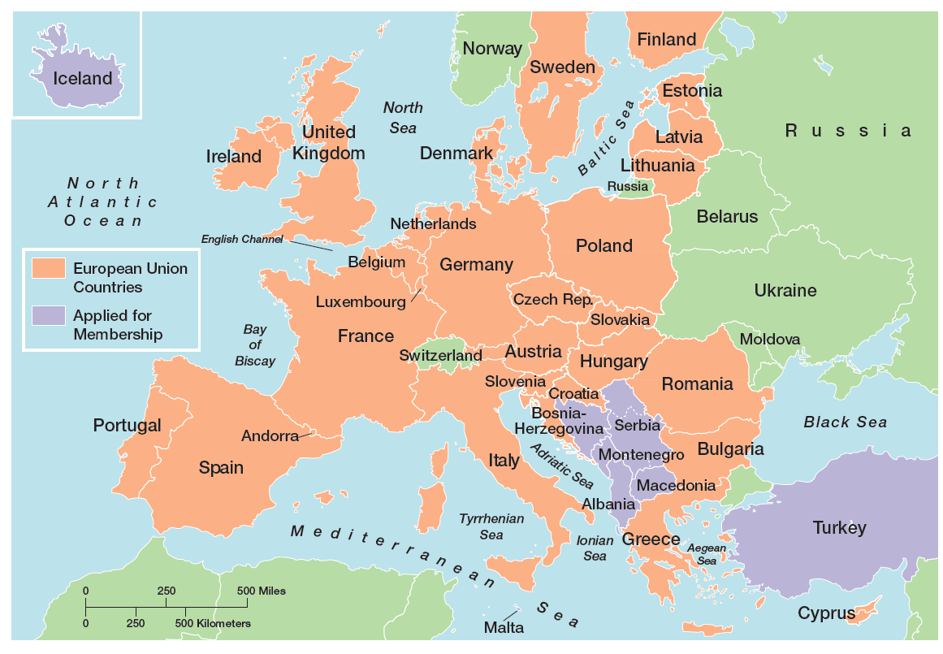
Exhibit 3-1 European Union Map
Exhibit 3-1 shows the members of the European Union.

Slide 8
North American Free Trade Agreement (NAFTA)
North American Free Trade Agreement (NAFTA): an agreement among the Mexican, Canadian, and U.S. governments in which barriers to trade have been eliminated
Notes:
When agreements in key issues covered by the North American Free Trade Agreement (NAFTA) were reached by the Mexican, Canadian, and U.S. governments in 1992, a vast economic agreement was created. It’s the second largest trade alliance in the world in terms of combined gross domestic product (GDP) of its members. Between 1994, when NAFTA went into effect, and 2014, imports from Canada and Mexico to the United States increased 212 percent and 637 percent, respectively. The rise in export activity from the United States to Canada and Mexico was 211 percent and 478 percent, respectively. Put into numbers, that translates to some $1.1 trillion ex- changed among NAFTA partners in 2014 alone.
Other Latin American nations have also become part of free trade agreements. Colombia, Mexico, and Venezuela led the way when all three signed an economic pact in 1994 eliminating import duties and tariffs. Another agreement, the U.S.–Central America Free Trade Agreement (CAFTA-DR), promotes trade liberalization between the United States and five Central American countries: Costa Rica, El Salvador, Guatemala, Honduras, and Nicaragua as well as the Dominican Republic.
Another free trade agreement of 10 South American countries known as the Southern Common Market or Mercosur already exists. Some South Americans see Mercosur as an effective way to combine resources to better compete against other global economic powers, especially the EU and NAFTA. With the future of FTAA highly doubtful, this regional alliance could take on new importance.

Slide 9
Association of Southeast Asian Nations (ASEAN)
Association of Southeast Asian Nations (ASEAN): a trading alliance of 10 Southeast Asian nations
Indonesia, Thailand, Singapore, Malaysia, Philippines, Vietnam, Myanmar (Burma), Laos, Brunei, Cambodia
Notes:
The Association of Southeast Asian Nations (ASEAN) is a trading alliance of 10 Southeast Asian nations (see Exhibit 4-2). The ASEAN region has a population of more than 625 million with a combined GDP of US $2.4 trillion.37 In addition to these 10 nations, leaders from a group dubbed ASEAN+3, which include China, Japan, and South Korea, have met to discuss trade issues. Also, leaders from India, Australia, and New Zealand have participated in trade talks with ASEAN+3 as well.
The main issue with creating a trade agreement of all 16 nations has been the lack of any push toward regional integration. Despite the Asian culture’s emphasis on consensus building, “ASEAN’s biggest problem is that individual members haven’t been willing to sacrifice for the common good.”

Slide 10
Other Trade Alliances
African Union (AU) (53 countries)
East African Community (EAC) (5 countries)
South Asian Association for Regional Cooperation (SAARC) (India, Pakistan, Sri Lanka, Bangladesh, Bhutan, Nepal, the Maldives, and Afghanistan)
Notes:
Other regions around the world have also developed regional trading alliances. For instance, the 54-nation African Union (AU), which came into existence in 2002, seeks to “build an integrated, prosperous and peaceful Africa, an Africa driven and managed by its own citizens and representing a dynamic force in the international arena.”
Five east African nations—Burundi, Kenya, Rwanda, Tanzania, and Uganda— have formed a common market called the East African Community (EAC).
The South Asian Association for Regional Cooperation (SAARC), composed of eight member states (India, Pakistan, Sri Lanka, Bangladesh, Bhutan, Nepal, the Maldives, and Afghanistan), began eliminating tariffs in 2006.
Finally, in 2015, 12 countries forged the terms of a trade alliance called the Trans-Pacific Partnership (TPP). The countries involved in the agreement include the United States, Canada, Mexico, Japan, Australia, and seven other countries around the Pacific region, excluding China (see Exhibit 4-3).

Slide 11
Global Trade Mechanisms
World Trade Organization (WTO)
International Monetary Fund (IMF)
World Bank Group
Organization for Economic Cooperation and Development (OECD)
Notes:
Global trade among nations doesn’t just happen on its own. As trade issues arise, global trade systems ensure that trade continues efficiently and effectively. Indeed, one of the realities of globalization is the interdependence of countries—that is, what happens in one can impact others, good or bad.
We’re going to look at four important global trade mechanisms: the World Trade Organization, the International Monetary Fund, the World Bank Group, and the Organization for Economic Cooperation and Development.

Slide 12
World Trade Organization
World Trade Organization (WTO): global organization of 153 countries that deals with the rules of trade among nations
Notes:
The World Trade Organization (WTO) is a global organization of 161 countries (as of April 2015) that deals with the rules of trade among nations.48 Formed in 1995, the WTO evolved from the General Agreement on Tariffs and Trade (GATT), a trade agreement in effect since the end of World War II. To- day, the WTO is the only global organization that deals with trade rules among nations. Its membership consists of 161 member countries and 24 observer governments (which have a specific time frame within which they must apply to become members).
The goal of the WTO is to help countries conduct trade through a system of rules. Although critics have staged vocal protests against the WTO, claiming that global trade destroys jobs and the natural environment, it appears to play an important role in monitoring, promoting, and protecting global trade.

Slide 13
International Monetary Fund and World Bank Group
International Monetary Fund (IMF): An organization of 185 countries that promotes international monetary cooperation and provides advice, loans, and technical assistance
World Bank Group: a group of very closely associated institutions that provides financial and technical assistance to developing countries
Notes:
Two other important and necessary global trade mechanisms include the International Monetary Fund and the World Bank Group. The International Monetary Fund (IMF) is an organization of 188 countries that promotes international monetary cooperation and provides member countries with policy advice, temporary loans, and technical assistance to establish and maintain financial stability and to strengthen economies. During the global financial turmoil of the last few years, the IMF was on the forefront of advising countries and governments in getting through the difficulties.
The World Bank Group is a group of five closely associated institutions, all owned by its member countries, that provides vital financial and technical assistance to developing countries around the world. The goal of the World Bank Group is to promote long-term economic development and poverty reduction by providing members with technical and financial support.

Slide 14
Organization for Economic Cooperation and Development
Organization for Economic Cooperation and Development (OECD): an international economic organization that helps its 30 member countries achieve sustainable economic growth and employment.
Notes:
The forerunner of the OECD, the Organization for European Economic Cooperation, was formed in 1947 to administer American and Canadian aid under the Marshall Plan for the reconstruction of Europe after World War II. Today, the Organization for Economic Cooperation and Development (OECD) is a Paris-based international economic organization whose mission is to help its 34 member countries achieve sustainable economic growth and employment and raise the standard of living in member countries while maintaining financial stability in order to contribute to the development of the world economy.
With a long history of facilitating economic growth around the globe, the OECD now shares its expertise and accumulated experiences with more than 80 developing and emerging market economies.

Slide 15
How Organizations Go International (1 of 2)
Global sourcing: purchasing materials or labor from around the world wherever it is cheapest
Notes:
When organizations do go international, they often use different approaches. (see Exhibit 4-4). Managers who want to get into a global market with minimal investment may start with global sourcing (also called global outsourcing), which is purchasing materials or labor from around the world wherever it is cheapest. The goal takes advantage of lower costs in order to be more competitive.
Although global sourcing may be the first step in going international for many companies, they often continue to use this approach because of the competitive advantages it offers. Each successive stage of going international beyond global sourcing, however, requires more investment and thus entails more risk for the organization.

Slide 16
Going Global: Exporting and Importing
Exporting: making products domestically and selling them abroad
Importing: acquiring products made abroad and selling them domestically
Notes:
The next step in going international may involve exporting the organization’s products to other countries—that is, making products domestically and selling them abroad.
In addition, an organization might do importing, which involves acquiring products made abroad and selling them domestically. Both usually entail minimal investment and risk, which is why many small businesses often use these approaches to doing business globally.

Slide 17
Going Global: Licensing and Franchising
Licensing: an organization gives another organization the right to make or sell its products using its technology or product specifications
Franchising: an organization gives another organization the right to use its name and operating methods (For service firms)
Notes:
Managers also might use licensing or franchising, which are similar approaches involving one organization giving another organization the right to use its brand name, technology, or product specifications in return for a lump sum payment or a fee usually based on sales.
The only difference is that licensing is primarily used by manufacturing organizations that make or sell another company’s products and franchising is primarily used by service organizations that want to use another company’s name and operating methods.

Slide 18
Going Global: Strategic Alliances and Joint Ventures
Strategic Alliance: partnership between an organization and foreign company partner(s) in which both share resources and knowledge in developing new products or building production facilities (Honda Motor and General Electric).
Joint Venture: A specific type of strategic alliance in which the partners agree to form a separate, independent organization for some business purpose
Notes:
When an organization has been doing business internationally for a while and has gained experience in international markets, managers may decide to make more of a direct foreign investment. One way to increase investment is through a strategic alliance, which is a partnership between an organization and a foreign company partner or partners in which both share resources and knowledge in developing new products or building production facilities. For example, Honda Motor and General Electric teamed up to produce a new jet engine.
A specific type of strategic alliance in which the partners form a separate, independent organization for some business purpose is called a joint venture. For example, Hewlett-Packard has had numerous joint ventures with various suppliers around the globe to develop different components for its computer equipment. British automaker Land Rover and Chinese automaker Chery created a joint venture, which aims to combine the experience of Britain’s luxury vehicle manufacturer with Chery’s deep understanding of the Chinese markets and customer preferences. These partnerships provide a relatively easy way for companies to compete globally.

Slide 19
Going Global: Foreign Subsidiary
Foreign Subsidiary: directly investing in a foreign country by setting up a separate and independent production facility or office
Notes:
Finally, managers may choose to directly invest in a foreign country by setting up a foreign subsidiary as a separate and independent facility or office. This subsidiary can be managed as a multidomestic organization (local control) or as a global organization (centralized control). As you can probably guess, this arrangement involves the greatest commitment of resources and poses the greatest amount of risk.

Slide 20
Managing in a Global Environment
What challenges will a manager face in a new country?
Notes:
Assume for a moment that you’re a manager going to work for a branch of a global organization in a foreign country. You know that your environment will differ from the one at home, but how? What should you look for?
Although our discussion is presented through the eyes of a U.S. manager, this framework could be used by any manager, regardless of national origin, who manages in a foreign environment.

Slide 21
Political/Legal Environment
U.S. managers are accustomed to a stable legal and political system
Managers must stay informed of the specific laws in countries where they do business
Some countries have risky political climates
Nationalization / Privatization in Pakistan and Zimbabwe pushing firms to sale stocks to locals
Iran, Iraq, Afghanistan, Somalia, Sudan, Venezuela, Yemen are high risky
Notes:
U.S. managers are accustomed to a stable legal and political system. Changes tend to be slow, and legal and political procedures are well established. Elections are held at regular intervals, and even when the political party in power changes after an election, it’s unlikely that anything too radical will happen. The stability of laws allows for accurate predictions. However, this certainly isn’t true for all countries.
Managers must stay informed of the specific laws in countries where they do business. For instance, the president of Zimbabwe is pushing ahead with plans to force foreign companies to sell majority stakes to locals.
Also, some countries have risky political climates. For instance, BP could have warned Exxon about the challenges of doing business in Russia. During its long involvement in the country, BP has “had so many police run-ins that its stock price often nudges up or down in response to raids or the arrests of employees.”
Keep in mind that a country’s political/legal environment doesn’t have to be risky or unstable to be a concern to managers. Just the fact that it differs from that of the home country is important. Managers must recognize these differences if they hope to understand the constraints and opportunities that exist.

Slide 22
Economic Environment
Free Market Economy: an economic system in which resources are primarily owned and controlled by the private sector
Planned Economy: an economic system in which economic decisions are planned by a central government
Other economic issues managers need to understand include currency exchange rates, inflation rates, and diverse tax policies.
Notes:
A global manager must be aware of economic issues when doing business in other countries. First, it’s important to understand a country’s type of economic system. The two major types are a free market economy and a planned economy. A free market economy is one in which resources are primarily owned and controlled by the private sector.
A planned economy is one in which economic decisions are planned by a central government. Actually, no economy is purely a free market or planned. For instance, the United States and United Kingdom are toward the free market end of the spectrum but do have governmental intervention and controls. The economies of Vietnam and North Korea are more planned. China is also a more planned economy, but until recently had been moving toward being a more free market economy.
Other economic issues managers need to understand include (1) currency exchange rates, (2) inflation rates, and (3) diverse tax policies.

Slide 23
Cultural Environment
National Culture—the values and attitudes shared by individuals from a specific country that shape their behavior and beliefs about what is important.
Notes:
As we know from Chapter 3, organizations have different cultures. Countries have cultures, too. National culture includes the values and attitudes shared by individuals from a specific country that shape their behavior and their beliefs about what is important. Legal, political, and economic differences among countries are fairly obvious. Getting information about cultural differences isn’t quite that easy! The primary reason? It’s difficult for natives to explain their country’s unique cultural characteristics to someone else.

